Slide 1

SOC Predicted and Tracked through Pedogenic Proxy
Igor Kuivjogi Fernandes
Diego Della Lunga
Gustavo Henrique Bessa de Lima
Mario Andrés Soto Valencia

Slide 2
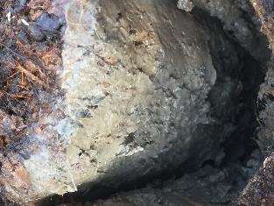
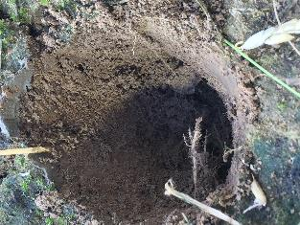
Problem Definition
Soil Organic Carbon Model:
a pedogenic approach
Anthropogenic pressure
SOM and anthropogenic processes: progressive, regressive.
Soil properties indicator of soil functions: Potential vs Actual

Slide 3
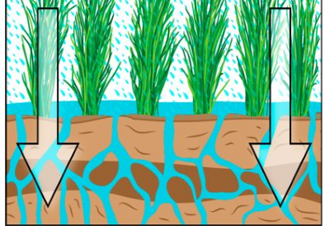
Problem Definition
Anthropic Pedogenesis
Earth system models: 5 soil-forming factors
Scorpan and spatial predictions
Assess and monitoring natural resource management
Kinetic energy: water infiltration
Runge Model
Lower Mississippi River Valley

Slide 4


Problem Definition
q_{ave}/$θ_{v=}$ v_{ave} (m s⁻¹)
(V_{ave} )² * 0.5(M)= KE (J)
KE

Slide 5
Data Sources
Variables
Precipitation
Evapotranspiration
Soil Volumetric Water Content
Bulk Density
Soil texture A Horizon
Soil Organic Carbon
Estimated Parameters
Porosity
VWC at saturation
VWC at field capacity

Slide 6
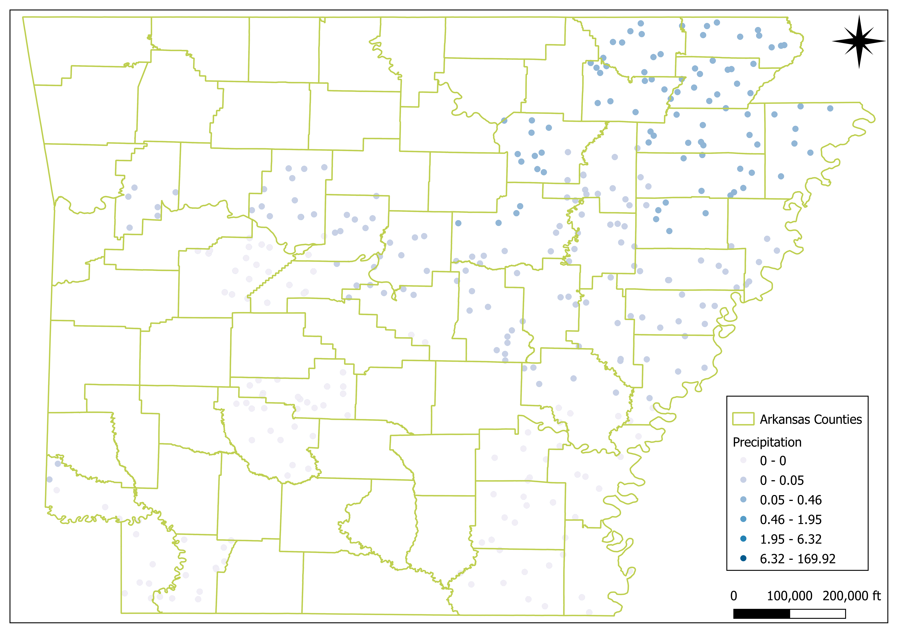

Data Sources
Precipitation
Nasa Power
Variable: PRECTOTCORR
Units: mm/day
Temporal resolution: Daily
Date: 2023-1-1 – 2023-8-31

Slide 7

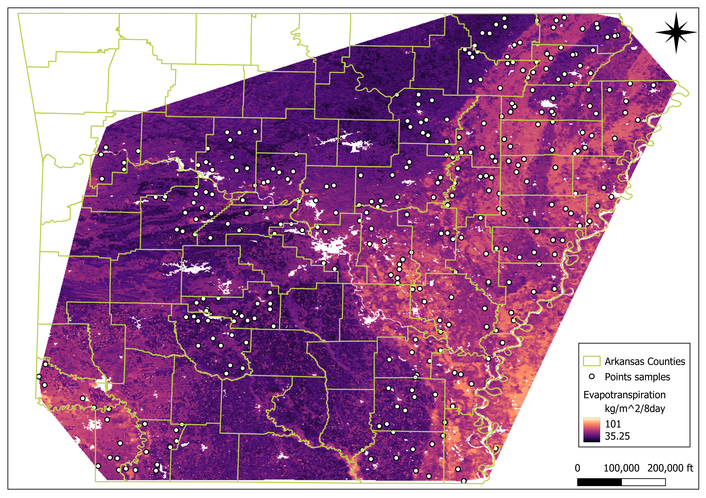
Data Sources
Evapotranspiration
Google Earth Engine
Collection: MOD16A2
Units: kg/m² 8day
Temporal resolution: 8 days
Date: 2023-1-1 – 2023-8-31
Preprocessing: Linear interpolation –> Daily

Slide 8
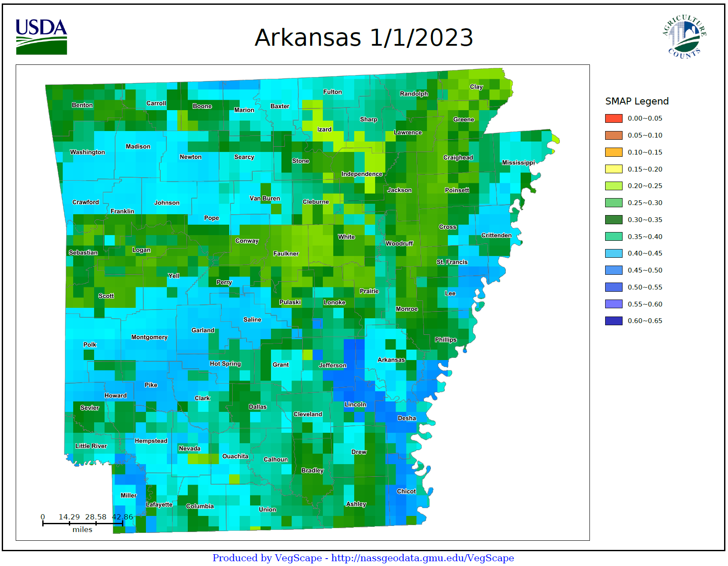

Data Sources
Soil Volumetric Water Content
Crop-CASMA
Collection: SMAP 9 Km Top 5cm
Units: cm³/cm³
Temporal resolution: Daily
Date: 2023-1-1 – 2023-8-31
Script: Dr. Leo Bastos

Slide 9
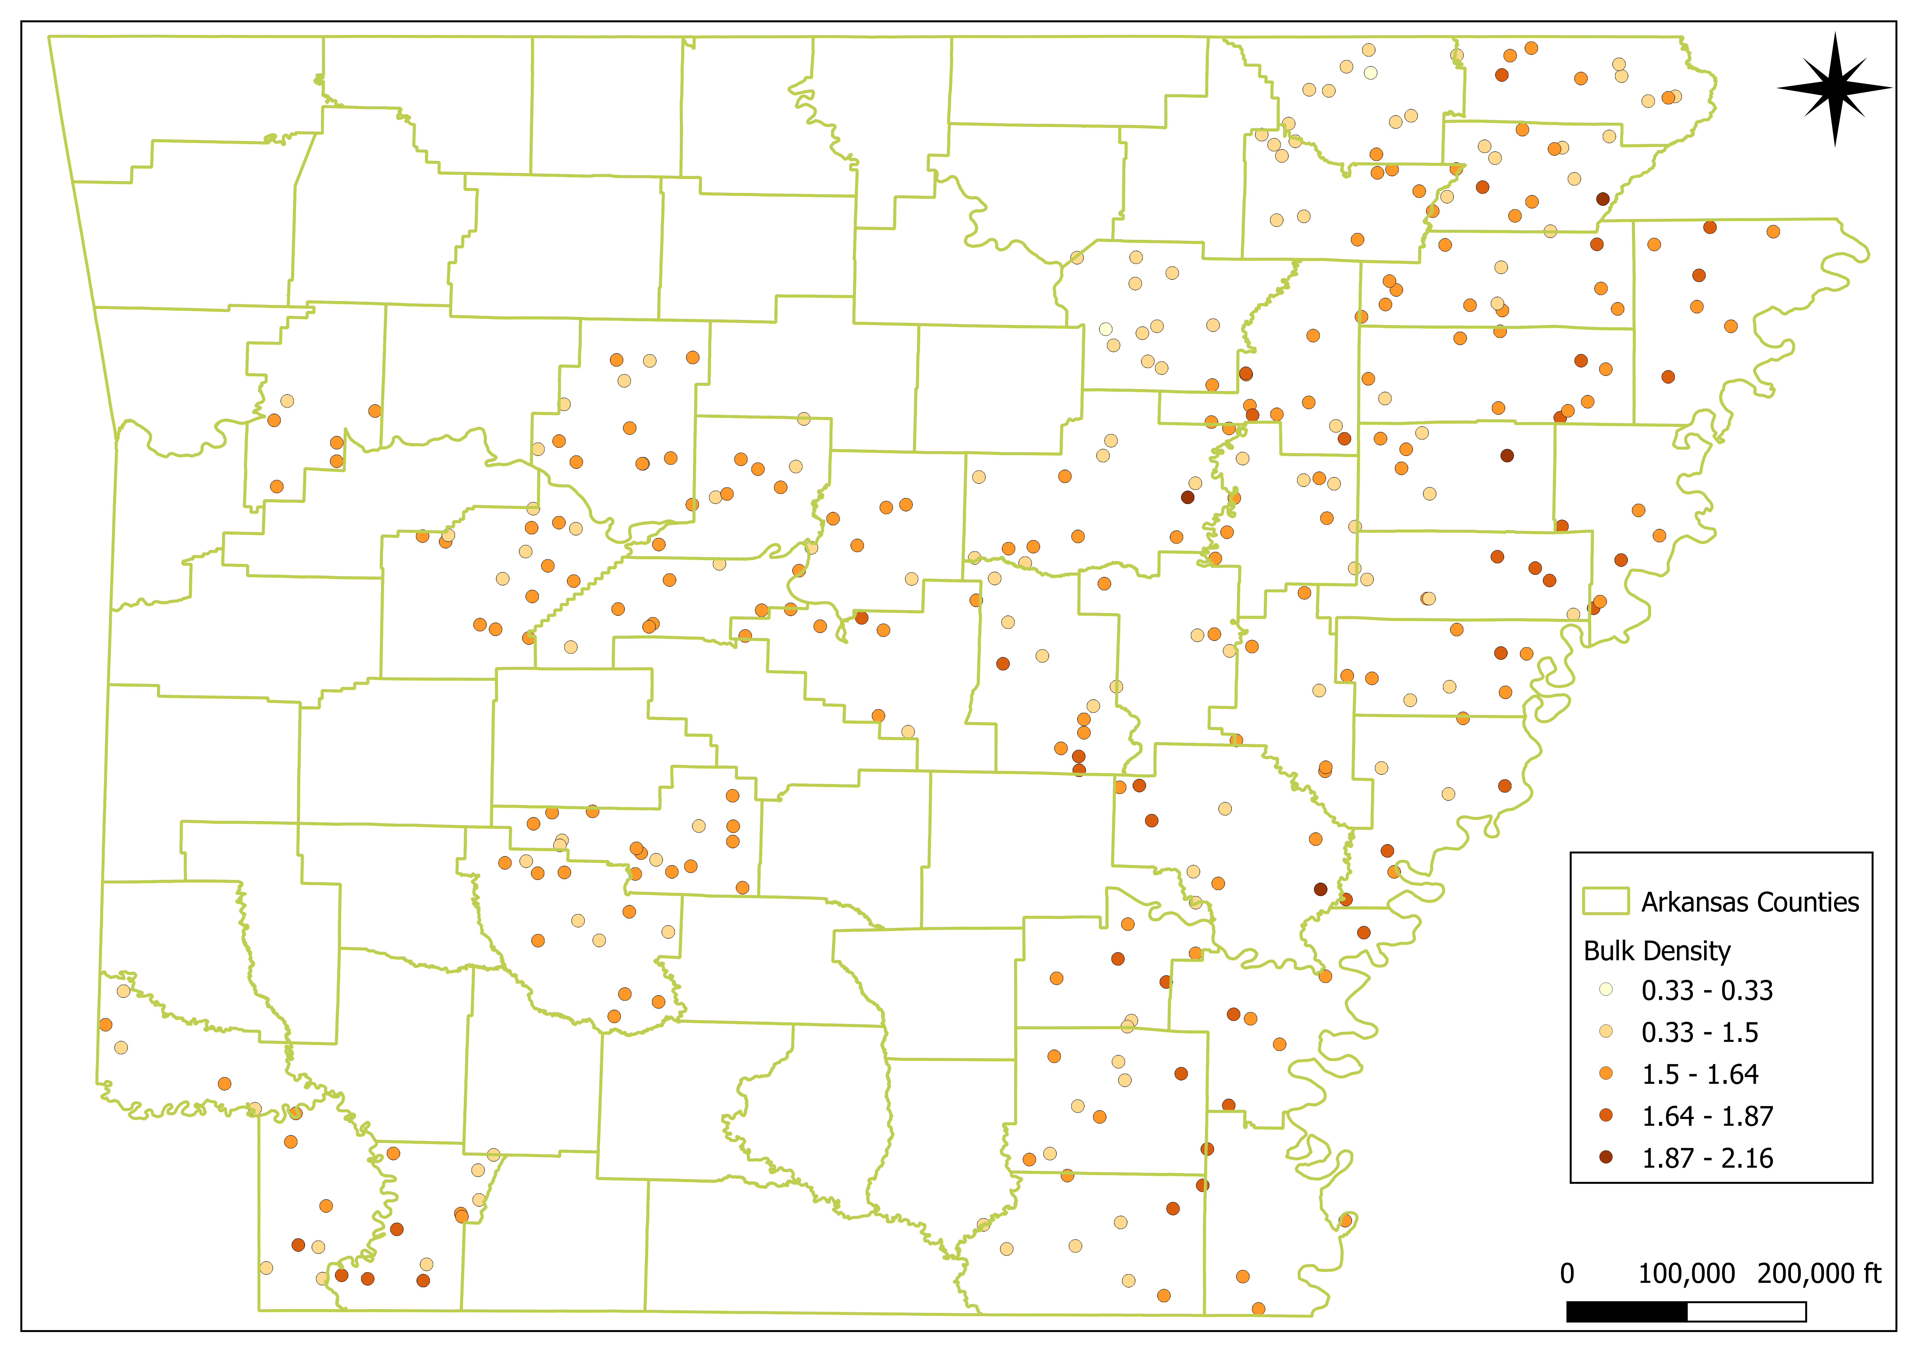

Data Sources
Soil
USDA: Web Soil Survey
Variables: Bulk Density, Soil texture A Horizon and Soil Organic Carbon
Units: kg/m²
Snapshot: September 2023
Script: D. E. Beaudette

Slide 10
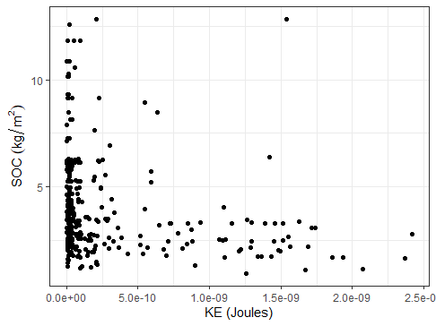
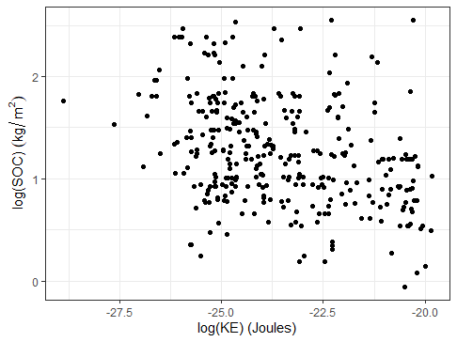
Model
Modelling
log-log
log(Y_{ij}) = µ + log(KE_{ij}) + c_{j} + e_{ij}
Y_{ij} is the SOC measured in the i-th point and the j-th county
µ is the intercept
KE_{ij} is the kinetic energy fixed effect
c_{j} is the random effect associated with the j-th county, with c_{j} ~ N(0, σ²_{c} )
e_{ij} is the residual of the i-th point and the j-th county, with e_{ij} ~ N(0, σ²_{e} )

Slide 11
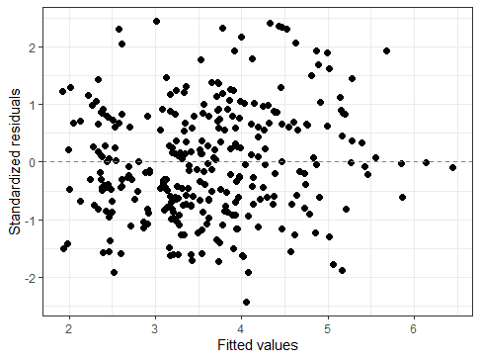
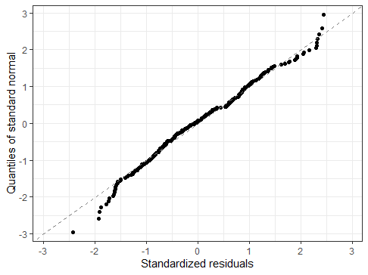
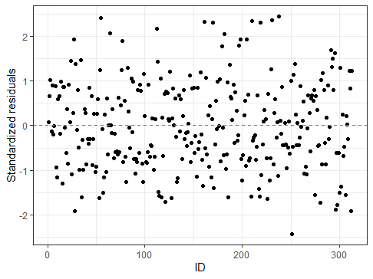
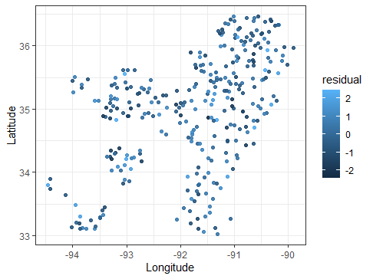
Model
Residuals

Slide 12
Model
Results
Fixed effects
 | Coefficient | Std. Error | p-value
Intercept | -1.538 | 0.342 | 1e-05
β₁ | -0.118 | 0.014 | 8e-15
Random effects
Metrics
 | Variance
County | 0.0272
Residual | 0.1459
Corr(y, ŷ) = 0.60
ICC = σ²_{c} / (σ²_{c} + σ²_{e} ) = 0.16

Slide 13
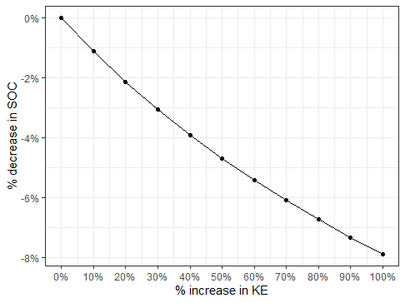
Model
Interpretation
For 1% increase on KE, there is a 0.118% decrease in SOC
20% increase in KE means [(1 + 0.2)^{-0.118} – 1] * 100% = -2.1% in SOC
 | Coefficient
Intercept | -1.538
Β₁ | -0.118

Slide 14
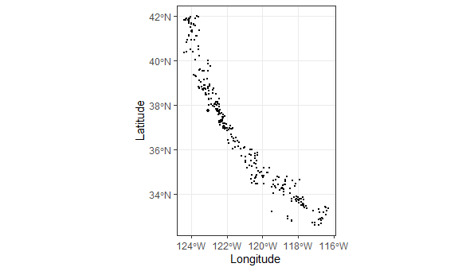
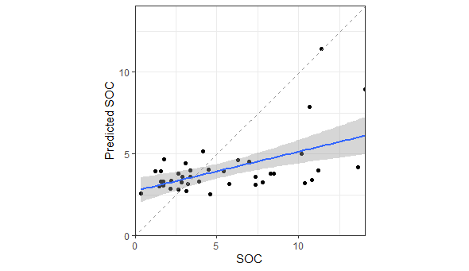
Model
Predictions in a new region
Coastal California
Corr(y, ŷ) = 0.54
County levels are new:
population-level predictions

Slide 15
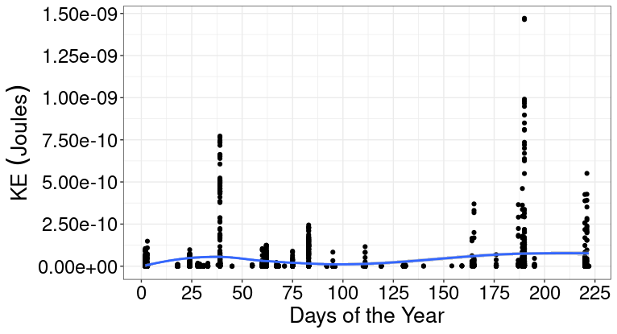
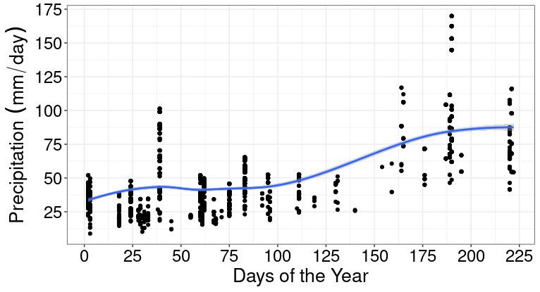
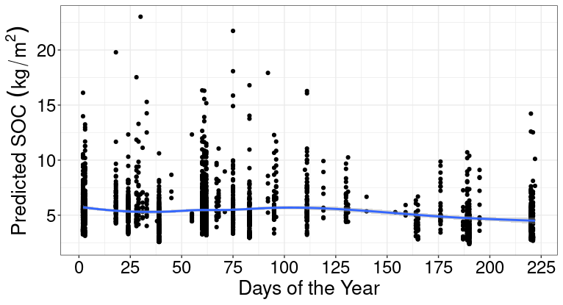
Implications
Discussion
Notes:
The model not only provides information of temporal and special distribution of soil organic carbon, but additionally provides information to address best agricultural management practices.
When we plot the Kinect energy of the entire year of the data we collect it, we can interpret the general trend over time.
We have the Kinect energy on the y axis and the days of the year on the x axis.
Only one year of data is not a reliable way to extrapolate the conclusion or recommendations.
Nevertheless, we can have clues that the model is working the way it is supposed to.
Kinetic energy seems to have a decrease trend in the middle of the graph which aligns with the growing season in Arkansas.
The range of soil organic carbon value has lower ranges during the growing season.
This appears to be related to the trends of precipitation.
When precipitation is higher, kinetic energy is higher when we potentially lose soil organic carbon.
The white gaps between points represent days when precipitation or kinetic energy were equal to zero.

Slide 16
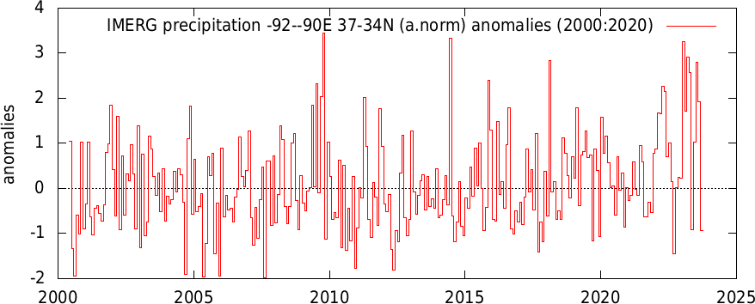
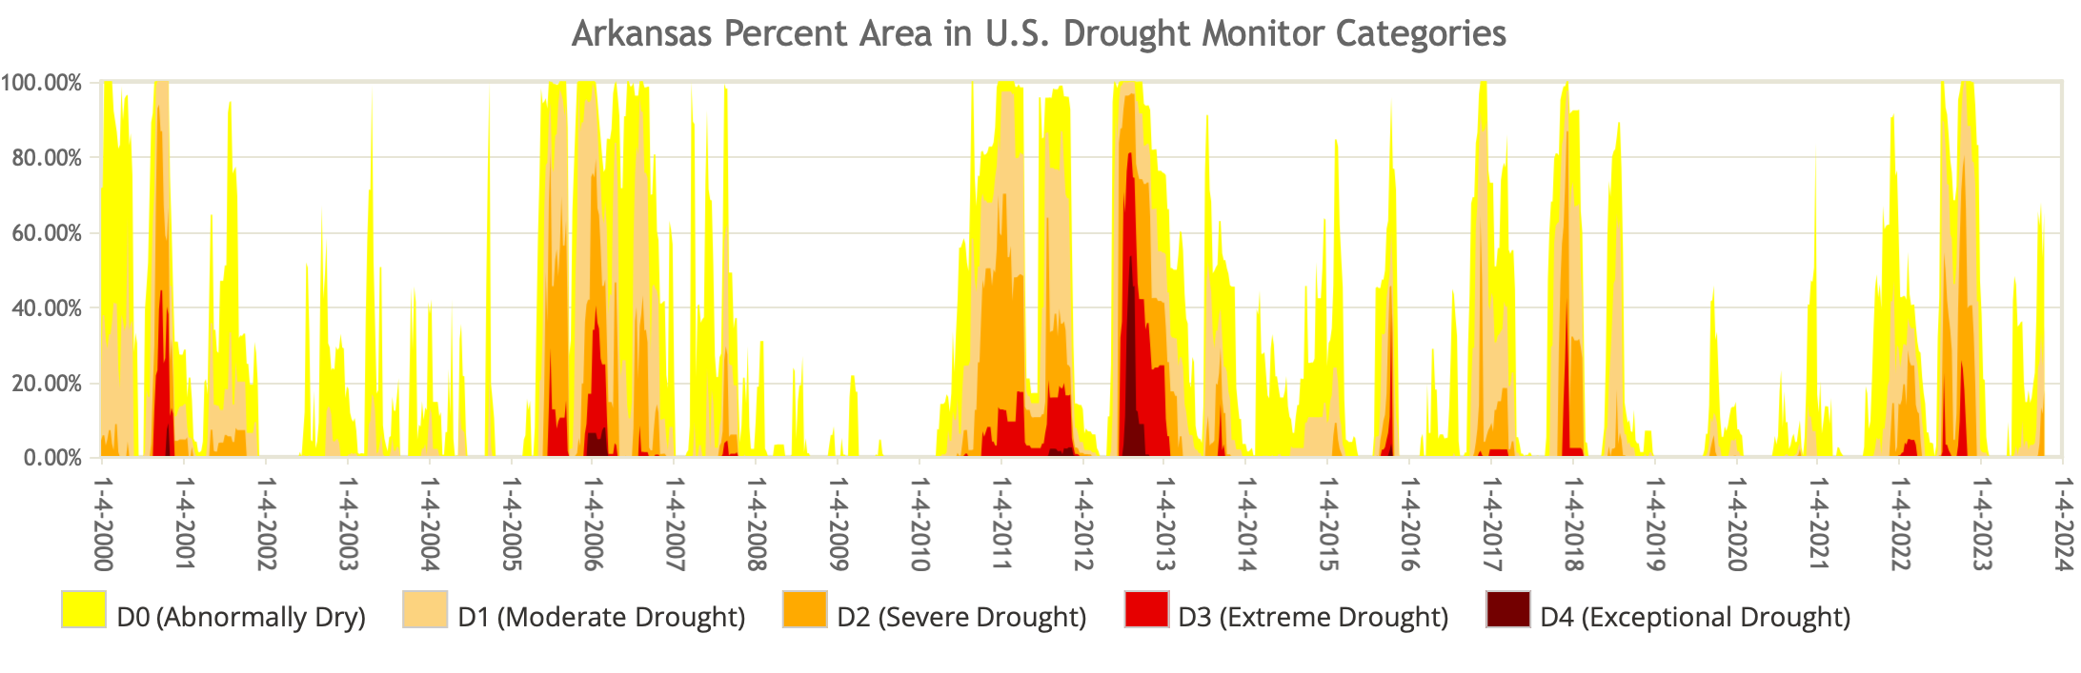
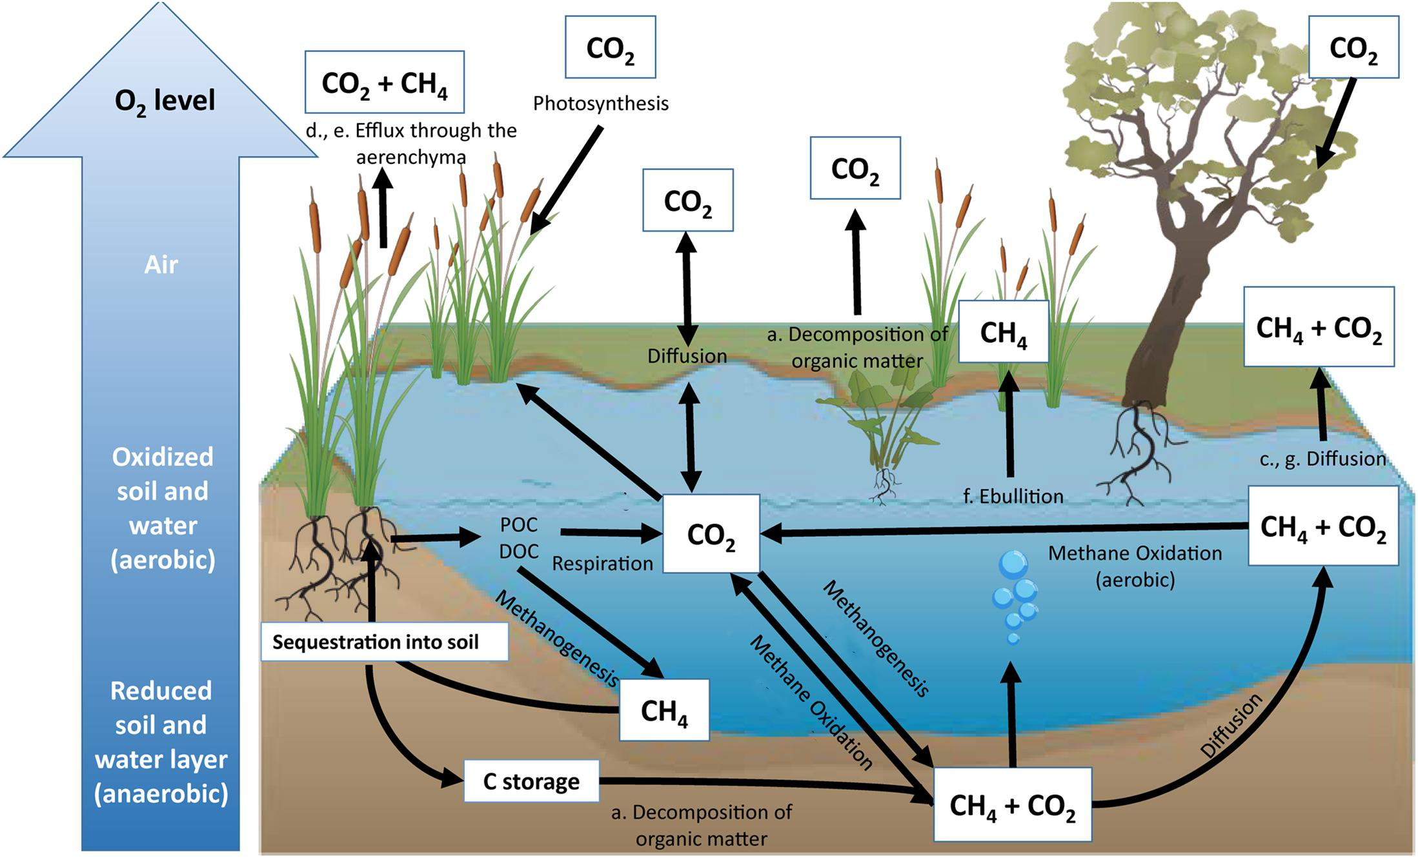
Impact
Discussion
Ecosystem specific
Thermodynamic Force of Greenhouse Gases
U.S. Drought Monitor
Climate explorer KNMI
Notes:
Why can this provide us useful information?
Because trend data for precipitation are suggesting the pattern in Arkansas is changing showing that we have great amount of precipitation outside of the growing season, coupled with longer drought during the growing seasons.
Therefore, management practices like organic amendments should be added only when Kinect energy is low, avoiding when weather pattern could cause the loss of organic material.
However, this model has narrower limitations.
It is ecosystem specific, meaning that outside of agricultural setting, the model should be rerun and the relationship between Kinect energy and organic carbon, should be redefined.
Additionally, thermodynamic forces should be added to the model, specifically production of methane and carbon dioxide, that are highly correlated to the soil organic matter turnover and are highly affected by water content.

Slide 17
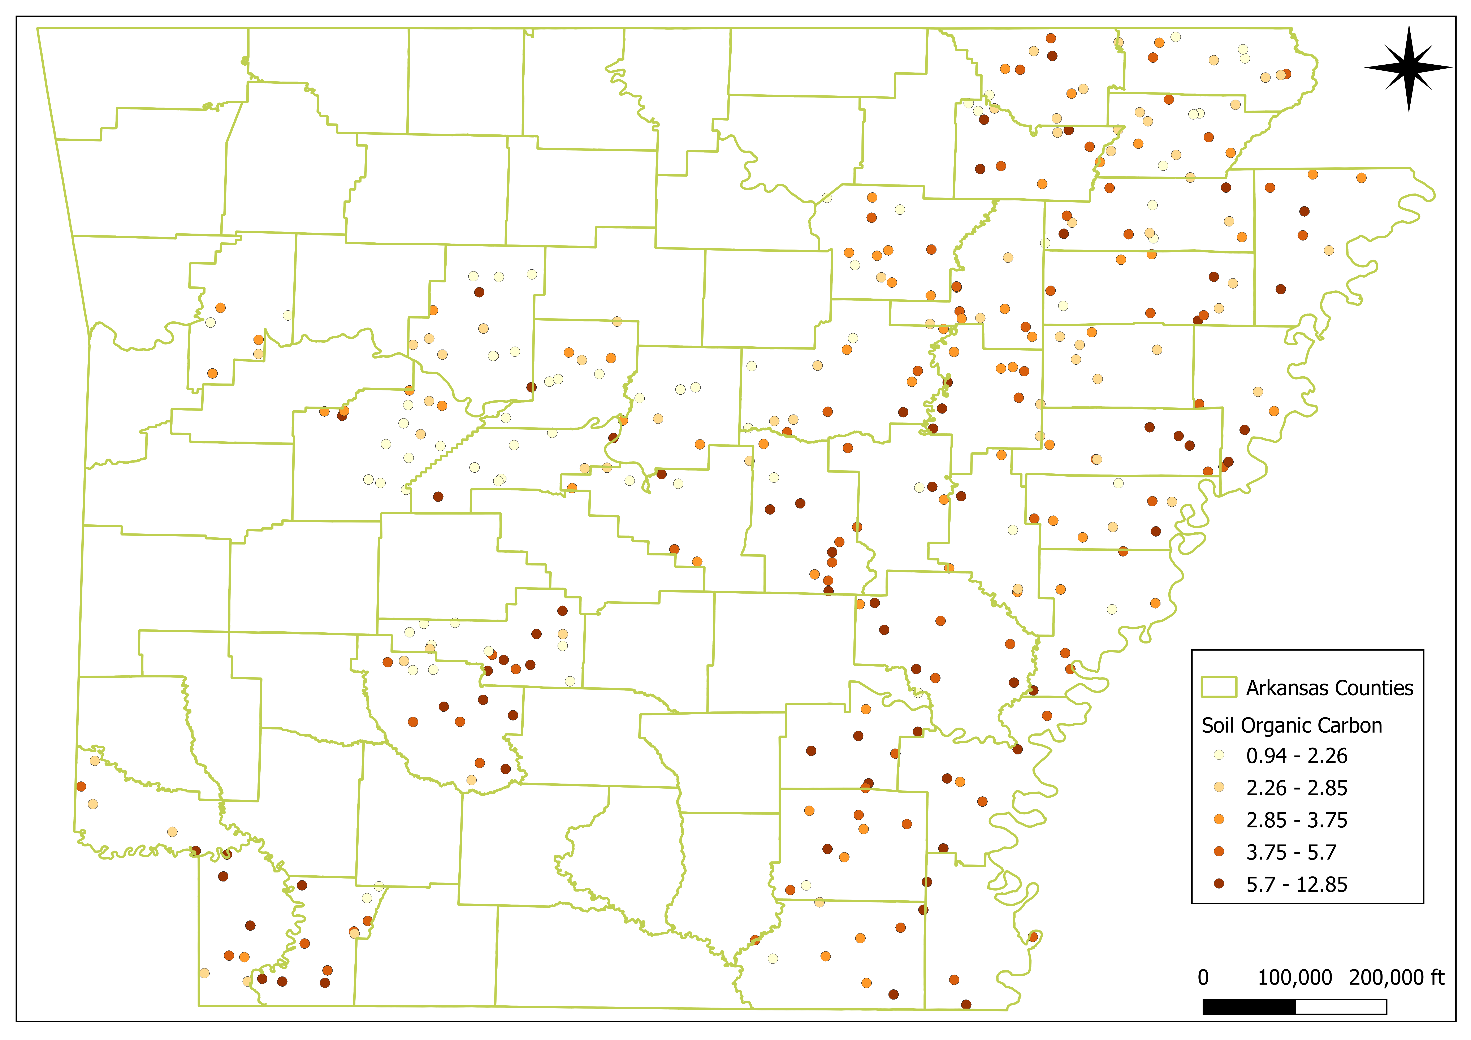
Conclusions
Final Remarks
SOC trend in Lower Mississippi River Valley
Multi-year time series
Management for KE
Residue incorporation
Organic amendments when KE is low
Notes:
Some conclusions that we can extrapolate from this study is that first, to have a reliable trend of soil organic carbon in the soil we need to have at least three years of data.
However, the temporal analysis of Kinect energy could provide appropriate windows of time for management like residue incorporation and organic amendments.
Although we realize that much work needs to be done to build a valid model, preliminary results confirm that the analysis reflects ground truth data.
Thank you for your attention and we will be happy to answer any questions that you may have.

Slide 18

Questions?

